Slide 1
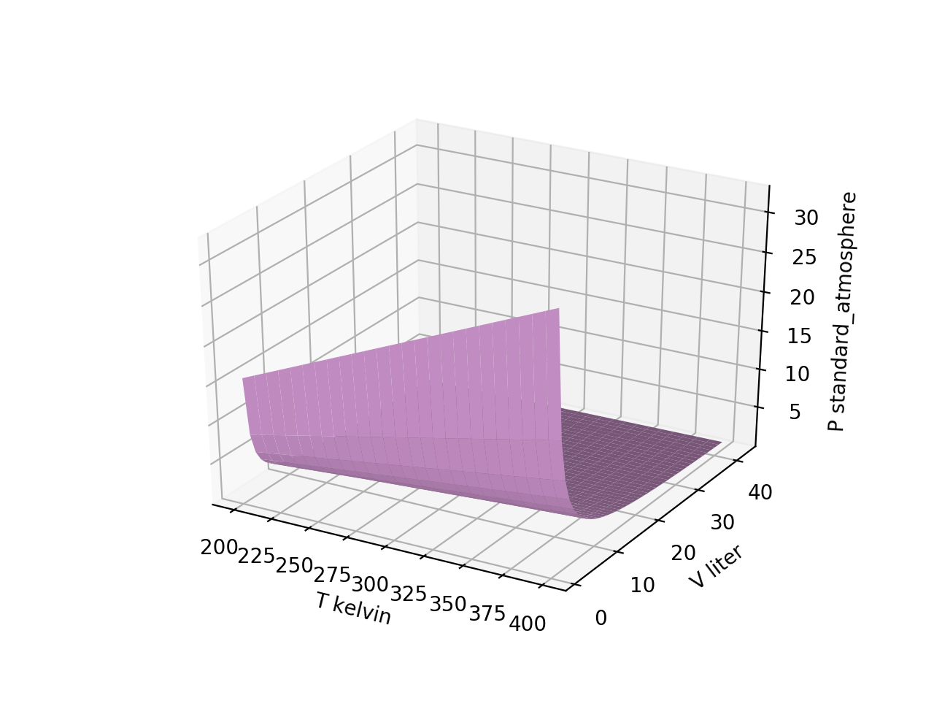
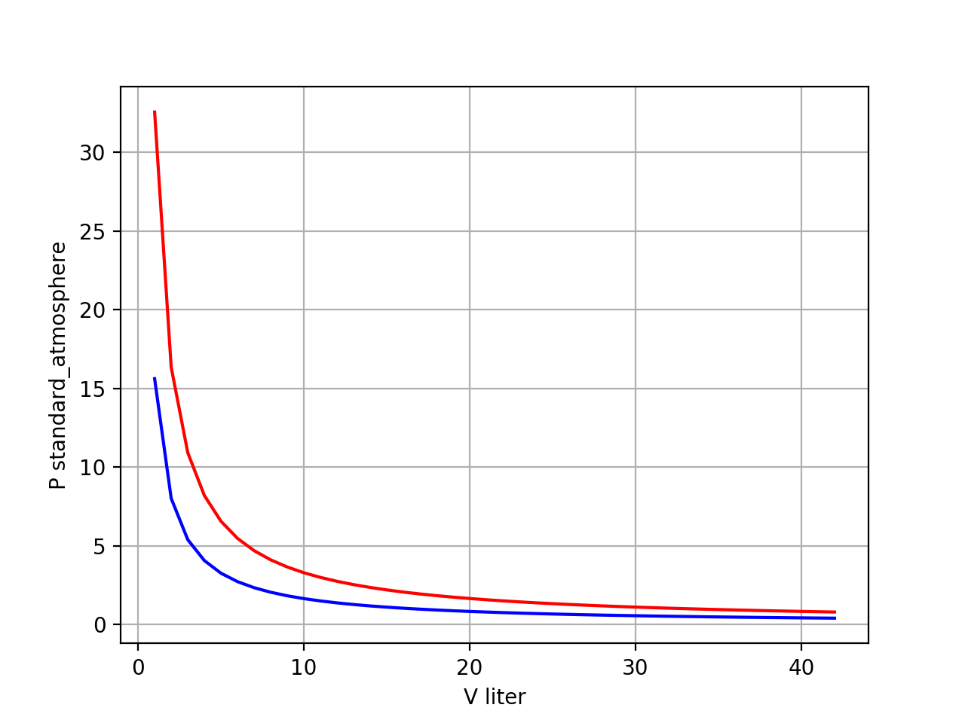
Recap: Slices of $P(T,V)$ are isotherms and isochores
isotherms
42 volumes
42 volumes

Slide 2
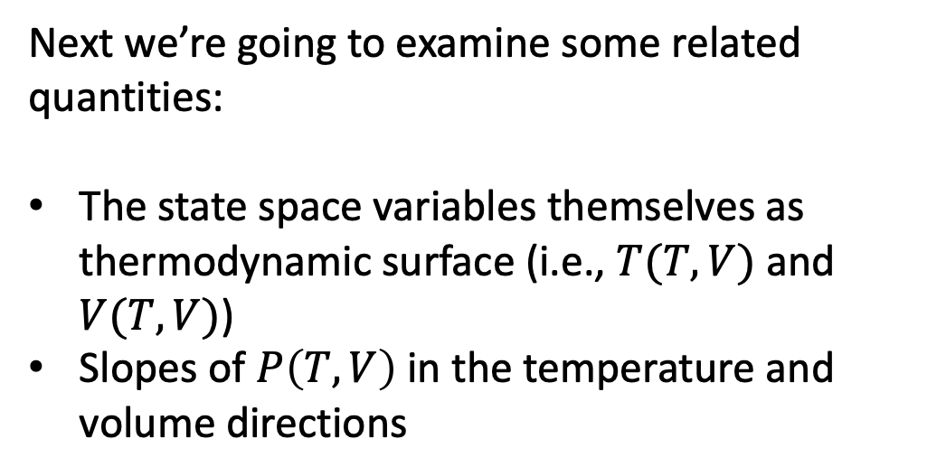
Today: Visualizing Partial Derivatives (as surfaces)
Next we’re going to examine some related quantities:
The state space variables themselves as thermodynamic surface (i.e., $T(T,V)$ and $V(T,V)$)
Slopes of $P\left(T,V\right)$ in the temperature and volume directions

Slide 3
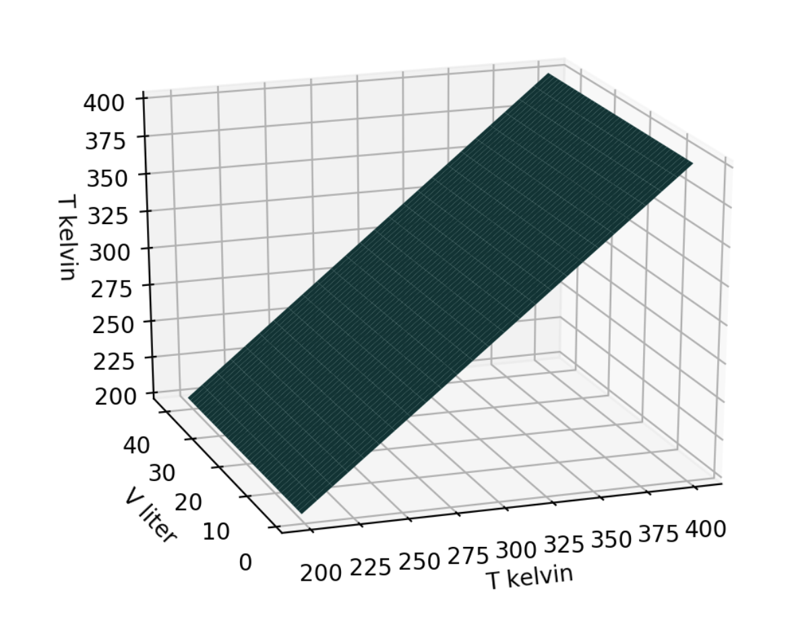
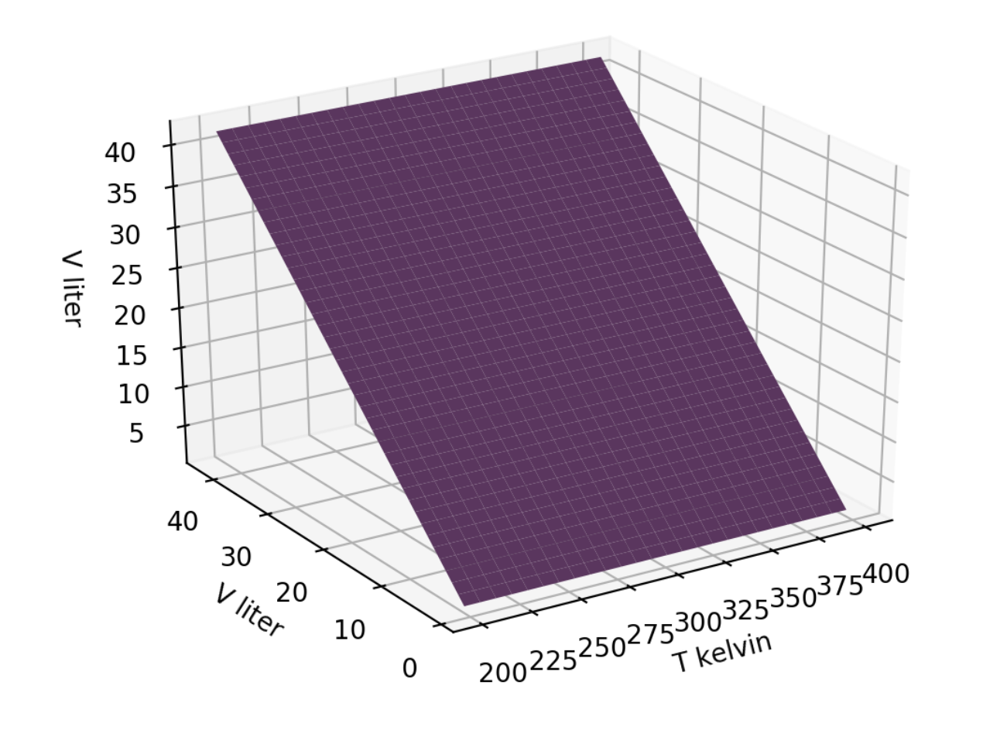


State space variables as thermodynamic surfaces
$$T\left(T,V\right)$$
$$V\left(T,V\right)$$
42 volumes
42 volumes
51 temperatures
51 temperatures

Slide 4
Indices in the grids allow us to refer to specific elements (scalars)
Tgrid[-1,-1]
Tgrid[50,0] = Tgrid[-1,0]
Tgrid[0,41] = Tgrid[0,-1]
Tgrid[0,0]

Slide 5
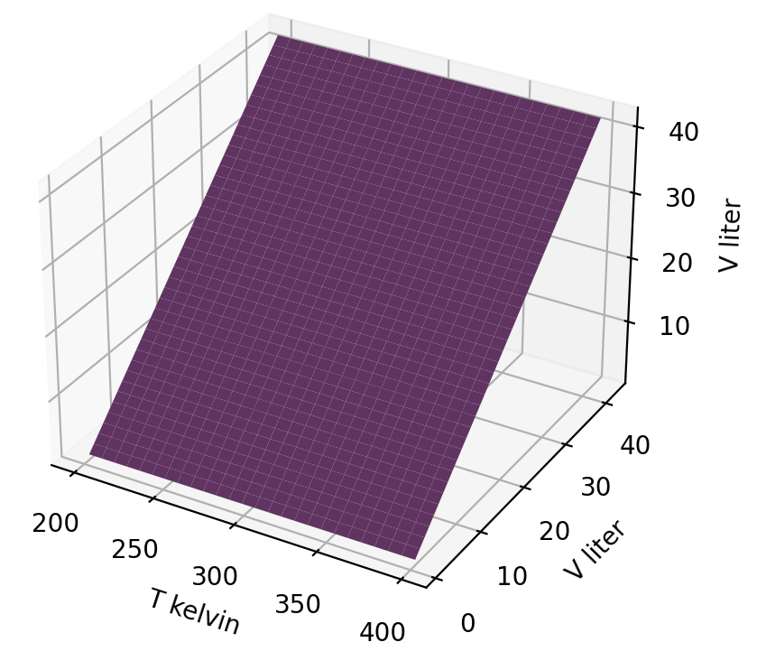
Indices in the grids allow us to refer to specific elements (scalars)
Vgrid[0,-1]
Vgrid[-1,-1]
Vgrid[0,0]
Vgrid[-1,0]

Slide 6
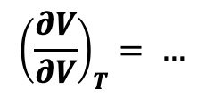
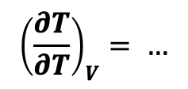
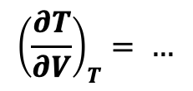


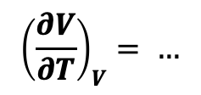
The “no-brainer” rules of partial derivatives
$$T\left(T,V\right)$$
$$V\left(T,V\right)$$
$${\left(\frac{∂T}{∂V}\right)}_{T}= …$$
$${\left(\frac{∂V}{∂V}\right)}_{T}= …$$
$${\left(\frac{∂T}{∂T}\right)}_{V}= …$$
$${\left(\frac{∂V}{∂T}\right)}_{V}= …$$

Slide 7
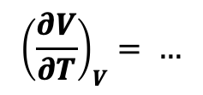
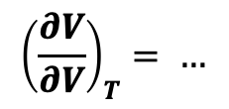
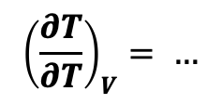
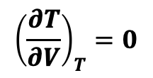
The “no-brainer” rules of partial derivatives
$$T\left(T,V\right)$$
$$V\left(T,V\right)$$
$${\left(\frac{∂T}{∂V}\right)}_{T}=0$$
$${\left(\frac{∂V}{∂V}\right)}_{T}= …$$
$${\left(\frac{∂T}{∂T}\right)}_{V}= …$$
$${\left(\frac{∂V}{∂T}\right)}_{V}= …$$

Slide 8
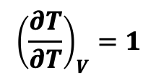
The “no-brainer” rules of partial derivatives
$$T\left(T,V\right)$$
$$V\left(T,V\right)$$
$${\left(\frac{∂T}{∂V}\right)}_{T}=0$$
$${\left(\frac{∂V}{∂V}\right)}_{T}= …$$
$${\left(\frac{∂T}{∂T}\right)}_{V}=1$$
$${\left(\frac{∂V}{∂T}\right)}_{V}= …$$

Slide 9
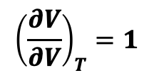
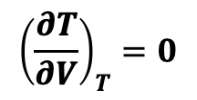
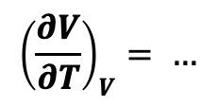
The “no-brainer” rules of partial derivatives
$$T\left(T,V\right)$$
$$V\left(T,V\right)$$
$${\left(\frac{∂T}{∂V}\right)}_{T}=0$$
$${\left(\frac{∂V}{∂V}\right)}_{T}=1$$
$${\left(\frac{∂T}{∂T}\right)}_{V}=1$$
$${\left(\frac{∂V}{∂T}\right)}_{V}= …$$

Slide 10
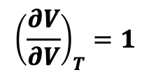
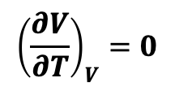
The “no-brainer” rules of partial derivatives
$$T\left(T,V\right)$$
$$V\left(T,V\right)$$
$${\left(\frac{∂T}{∂V}\right)}_{T}=0$$
$${\left(\frac{∂V}{∂V}\right)}_{T}=1$$
$${\left(\frac{∂T}{∂T}\right)}_{V}=1$$
$${\left(\frac{∂V}{∂T}\right)}_{V}=0$$

Slide 11
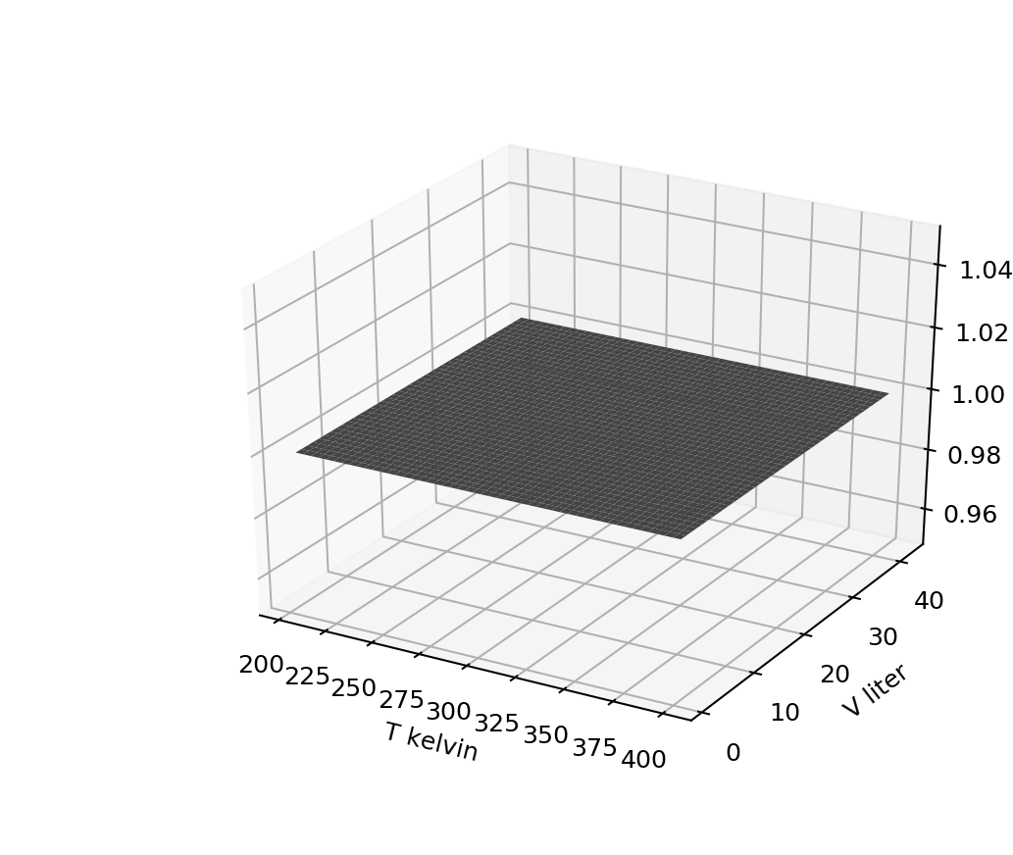
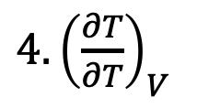
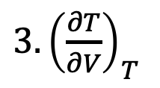
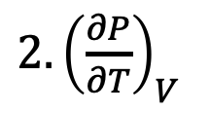
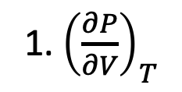
Just checking …
Which thermodynamic surface is this?
1. ${\left(\frac{∂P}{∂V}\right)}_{T}$
$2. {\left(\frac{∂P}{∂T}\right)}_{V}$
${3. \left(\frac{∂T}{∂V}\right)}_{T}$
${4. \left(\frac{∂T}{∂T}\right)}_{V}$
Notes:
Week 2

Slide 12
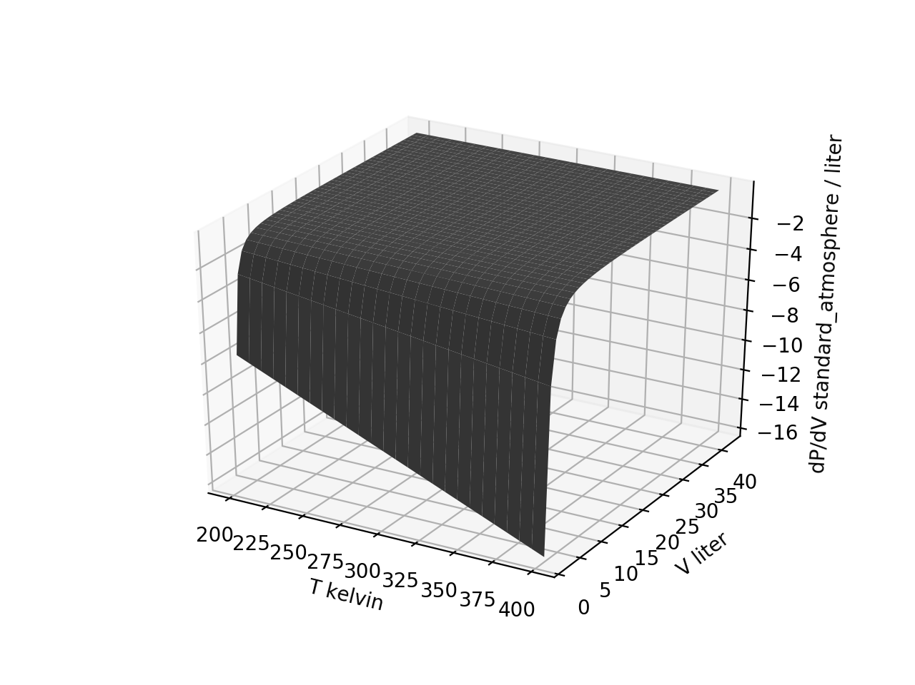
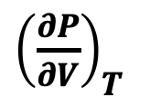

Slopes (with respect to volume) of the entire $P\left(T,V\right)$ surface
${\left(\frac{∂P}{∂V}\right)}_{T}$
$$P\left(T,V\right)$$

Slide 13
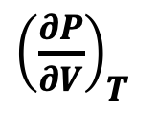

Slopes (with respect to volume) of the entire $P\left(T,V\right)$ surface
${\left(\frac{∂P}{∂V}\right)}_{T}$
$$P\left(T,V\right)$$

Slide 14
Slopes (with respect to volume) of the entire $P\left(T,V\right)$ surface
${\left(\frac{∂P}{∂V}\right)}_{T}$
$$P\left(T,V\right)$$
42 volumes
41 volumes
51 temperatures
51 temperatures

Slide 15
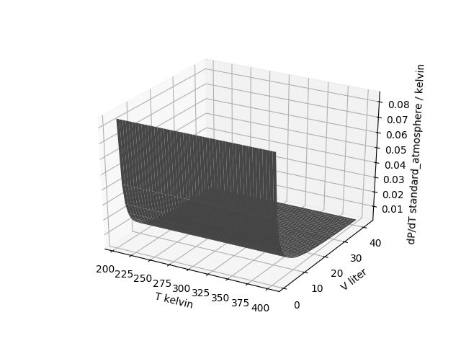
Slopes (with respect to temperature) of the entire $P\left(T,V\right)$ surface
42 volumes
42 volumes
51 temperatures
50 temperatures

Slide 16
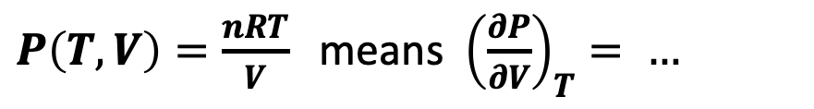
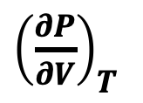

${\left(\frac{∂P}{∂V}\right)}_{T}$ of the entire $P\left(T,V\right)$ surface when you have an analytical representation of $P\left(T,V\right)$
$P\left(T,V\right)=\frac{nRT}{V}$ means ${\left(\frac{∂P}{∂V}\right)}_{T}= …$
${\left(\frac{∂P}{∂V}\right)}_{T}$
$$P\left(T,V\right)$$

Slide 17
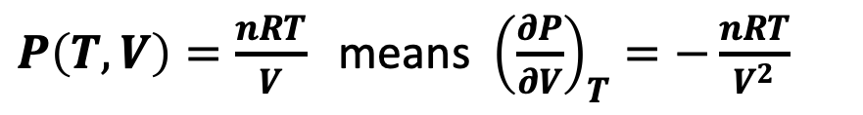
${\left(\frac{∂P}{∂V}\right)}_{T}$ of the entire $P\left(T,V\right)$ surface when you have an analytical representation of $P\left(T,V\right)$
$P\left(T,V\right)=\frac{nRT}{V}$ means ${\left(\frac{∂P}{∂V}\right)}_{T}=−\frac{nRT}{V^{2}}$
${\left(\frac{∂P}{∂V}\right)}_{T}$
$$P\left(T,V\right)$$

Slide 18
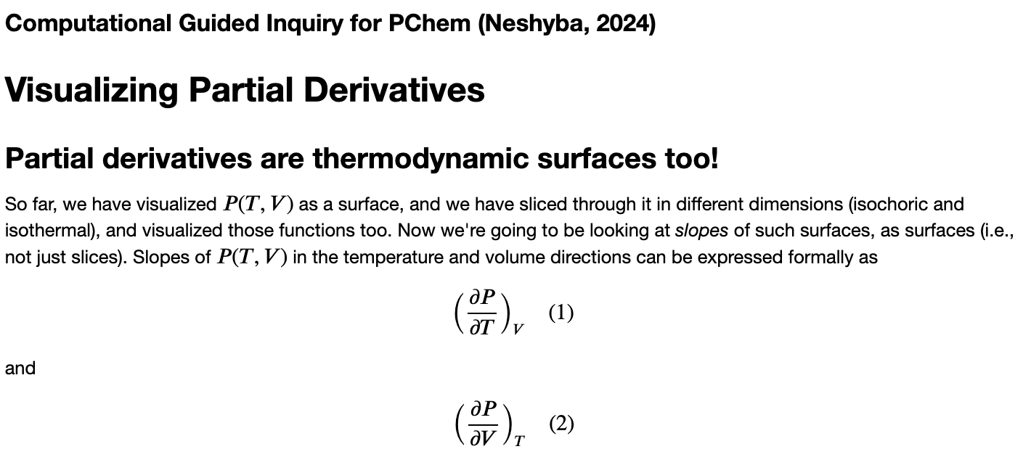
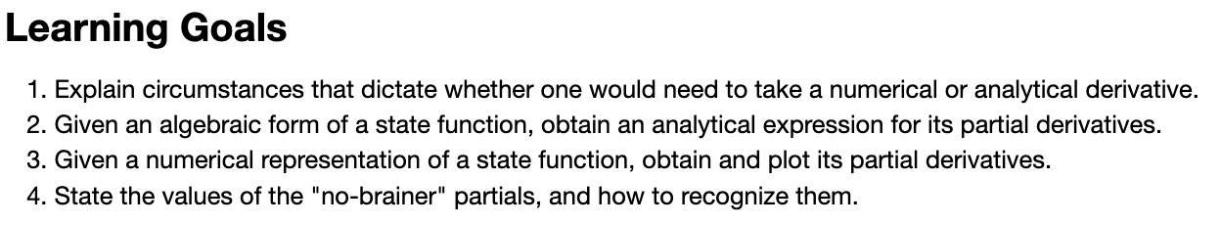
OK, let’s get started

